Slide 1
Decorators Generators

Slide 2



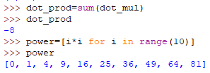

List Comprehensions
List comprehensions are a tool for transforming one list (any itterable actually) into another list. During this transformation, elements can be conditionally included in the new list and each element can be transformed as needed.
Syntax:
[<expression> for <value> in <collection> if <condition>]
doubled_odds = [n * 2 for n in range(10) if n % 2 == 1]
Traditional for loop
The same code written as a comprehension:
Filtering:
Notes:
List Comprehensions (Синаксичний цукор) - це спосіб компактного опису операцій по роботі зі списками.
List Comprehensions повертають список
winning_lottery_numbers = [0, 4, 3, 2, 3, 1] fake_lottery_numbers = [2*n for n in winning_lottery_numbers]
list = [n for n in range(1, 10000) if n % 2 == 0]
list = [random.random() for i in range(100)]
Here’s a for loop that flattens a matrix (a list of lists):
flattened = []
for row in matrix:
for n in row:
flattened.append(n)
Here’s a list comprehension that does the same thing:
flattened = [n for row in matrix for n in row]
list = [(x, y) for x in range(1, 10) for y in range(1, 10) if x % y == 0]

Slide 3
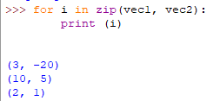

Multi-variable functions in a single line using zip
Make an iterator that aggregates elements from each of the iterables.
Returns an iterator of tuples, where the i-th tuple contains the i-th element from each of the argument sequences or iterables. The iterator stops when the shortest input iterable is exhausted. With a single iterable argument, it returns an iterator of 1-tuples.
zip(*iterables)

Slide 4


lambda vs def
def - is a keyword that doesn't return anything and creates a 'name' in the local namespace.
lambda - is a keyword that returns a function object and does not create a 'name' in the local namespace.
def - can contain any python code
lambda - has to evaluate to an expression, and can thus not contain statements like print, import, raise, ...
Syntax:
[fnName] = lambda [args]: expression
So… why use lambda?
Usually for scenarios when you need to pass a function as a parameter into another function. For example when we are using map(), filter() and reduce() …
Notes:
If you need to assign the lambda to a name, use a def instead. defs are just syntactic sugar for an assignment, so the result is the same, and they are a lot more flexible and readable.
lambdas can be used for use once, throw away functions which won't have a name.
However, this use case is very rare. You rarely need to pass around unnamed function objects.
The builtins map() and filter() need function objects, but list comprehensions and generator expressions are generally more readable than those functions and can cover all use cases, without the need of lambdas.
For the cases you really need a small function object, you should use the operator module functions, like operator.add instead of lambda x, y: x + y
If you still need some lambda not covered, you might consider writing a def, just to be more readable. If the function is more complex than the ones at operator module, a def is probably better.
So, real world good lambda use cases are very rare.

Slide 5

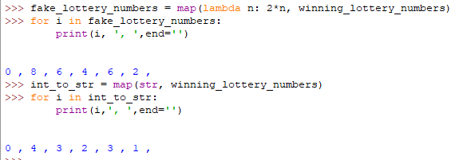
Map, Filter and Reduce
Syntax:
result = map(aFunction, aSequence)
map applies a function to all the items in a sequence.
Compare to list comprehension:

Slide 6
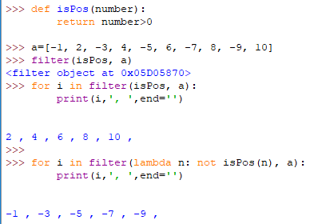
Map, Filter and Reduce
Syntax:
result = filter(aFunction, aSequence)
filter creates a list of elements for which a function returns true.

Slide 7

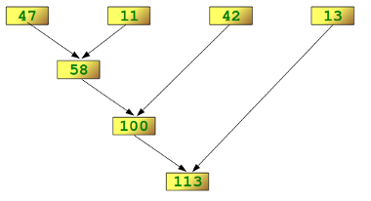


Map, Filter and Reduce
reduce - cumulatively performs an operation on all the iterable’s elements and, therefore, can’t be applied to infinite iterables. aFunction must be a function that takes two elements and returns a single value.
Syntax:
result = reduce(aFunction, aSequence, [initial])
NOTE: results get accumulated on the left, and new values applied to the right.
so reduce(add, [1,2,3,4]) is processed as (((1+2)+3)+4)

Slide 8
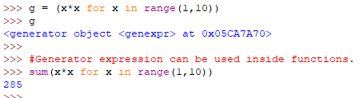
Generator expressions
The syntax of generator expression says that always needs to be directly inside a set of parentheses and cannot have a comma on either side. Which basically means both the examples below are valid generator expression usage example.
Notes:
В мові Пайтон, також є вирази-генератори, які мають схожий синтаксис з List Comprehensions (спискові включення) але повертають об’єкт ітератор
It is fairly simple to create a generator in Python. It is as easy as defining a normal function with yield statement instead of a return statement.

Slide 9
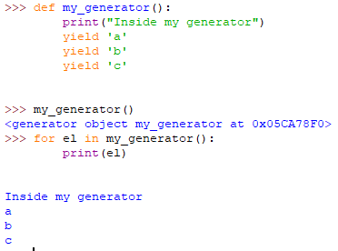
Generator
It is as easy as defining a normal function with yield statement instead of a return statement.
The difference is that, while a return statement terminates a function entirely, yield statement pauses the function saving all its states and later continues from there on successive calls.
Once the function yields, the function is paused and the control is transferred to the caller.
Notes:
It is fairly simple to create a generator in Python. It is as easy as defining a normal function with yield statement instead of a return statement.
If a function contains at least one yield statement (it may contain other yield or return statements), it becomes a generator function. Both yield and return will return some value from a function.
The difference is that, while a return statement terminates a function entirely, yield statement pauses the function saving all its states and later continues from there on successive calls.
https://www.programiz.com/python-programming/generator

Slide 10
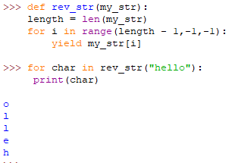
Python Generators with a Loop

Slide 11


Decorators
We can use the @ symbol along with the name of the decorator function and place it above the definition of the function to be decorated. For example,
Python has an interesting feature called decorators to add functionality to an existing code.
This is also called metaprogramming as a part of the program tries to modify another part of the program at compile time.
This is just a syntactic sugar to implement decorators.

Slide 12
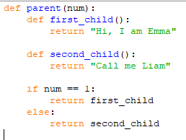
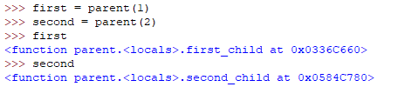

Returning Functions From Functions
Python also allows you to use functions as return values. The following example returns one of the inner functions from the outer parent() function:
The somewhat cryptic output simply means that the first variable refers to the local first_child() function inside of parent(), while second points to second_child().
You can now use first and second as if they are regular functions, even though the functions they point to can’t be accessed directly:

Slide 13
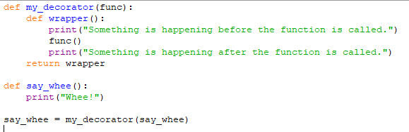
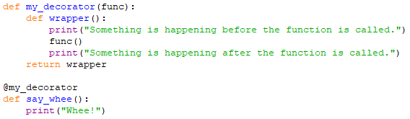

Simple Decorators
In effect, the name say_whee now points to the wrapper() inner function.
However, wrapper() has a reference to the original say_whee() as func, and calls that function between the two calls to print().
Put simply: decorators wrap a function, modifying its behavior.

Slide 14
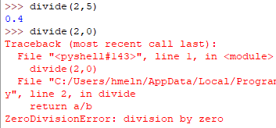

Decorating Functions with Parameters
The above decorator was simple and it only worked with functions that did not have any parameters. What if we had functions that took in parameters like below?

Slide 15
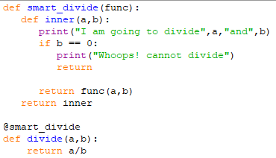
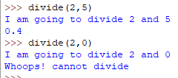
Decorating Functions with Parameters
Now let's make a decorator to check for this case that will cause the error.

Slide 16
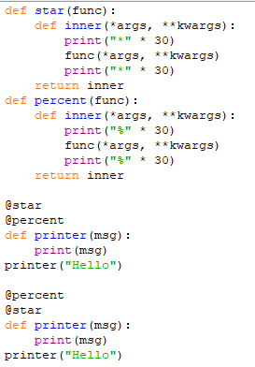
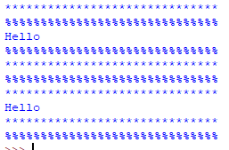
Chaining Decorators in Python
Multiple decorators can be chained in Python.
This is to say, a function can be decorated multiple times with different (or same) decorators. We simply place the decorators above the desired function.
The order in which we chain decorators matter. If we had reversed the order as,

Slide 17
Introduction To Files In Python
Notes:
Introduction to files in Pascal
17

Slide 18
What You Need In Order To Read Information From A File
Open the file and associate the file with a file variable.
A command to read the information.
A command to close the file.
Notes:
Introduction to files in Pascal
18

Slide 19
Opening Files
Prepares the file for reading:
Links the file variable with the physical file (references to the file variable are references to the physical file).
Positions the file pointer at the start of the file.
Format:
<file variable> = open(<file name>, "r")
Example:
(Constant file name)
inputFile = open("data.txt", "r")
OR
(Variable file name: entered by user at runtime)
filename = input("Enter name of input file: ")
inputFile = open(filename, "r")
1 Examples assume that the file is in the same directory/folder as the Python program.
Notes:
Introduction to files in Pascal
19
“r” open file for reading
“w” open file for writing
“c” open file for reading or writing, if the file doesn’t exist then create it
“n” create a new file for reading or writing, if the file exists then it’s contents are overwritten.
“a” open the file for appending, create the file if it doesn’t exist

Slide 20
Positioning the File Pointer
A
B
C
B
B
:
letters.txt
Notes:
Introduction to files in Pascal
20

Slide 21
Reading Information From Files
Typically reading is done within the body of a loop
Each execution of the loop will read a line from the file into a string
Format:
for <variable to store a string> in <name of file variable>:
<Do something with the string read from file>
Example:
for line in inputFile:
print(line) # Echo file contents back onscreen
Notes:
Introduction to files in Pascal
21

Slide 22
Closing The File
Although a file is automatically closed when your program ends it is still a good style to explicitly close your file as soon as the program is done with it.
What if the program encounters a runtime error and crashes before it reaches the end? The input file may remain ‘locked’ an inaccessible state because it’s still open.
Format:
<name of file variable>.close()
Example:
inputFile.close()

Slide 23
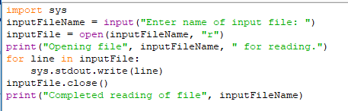

Reading From Files: Putting It All Together
Input file: letters.txt
Notes:
Introduction to files in Pascal
23
Draw out memory allocations as well as files allocated on disk.
Show the connection make between the file variable and the file with the reset statement.

Slide 24
What You Need To Write Information To A File
Open the file and associate the file with a file variable (file is “locked” for writing).
A command to write the information.
A command to close the file.
Notes:
Introduction to files in Pascal
24

Slide 25
Opening The File
Format¹:
<name of file variable> = open(<file name>, "w")
Example:
(Constant file name)
outputFile = open("gpa.txt", "w")
(Variable file name: entered by user at runtime)
outputFileName = input("Enter the name of the output file
to record the GPA's to: ")
outputFile = open(outputFileName, "w")
1 Typically the file is created in the same directory/folder as the Python program.
Notes:
Introduction to files in Pascal
25
“r” open file for reading
“w” open file for writing
“c” open file for reading or writing, if the file doesn’t exist then create it
“n” create a new file for reading or writing, if the file exists then it’s contents are overwritten.
“a” open the file for appending, create the file if it doesn’t exist
Show how to read single line: see Gaddis

Slide 26
2. Writing To A File
You can use the ‘write()’ function in conjunction with a file variable.
Note however that this function will ONLY take a string parameter (everything else must be converted to this type first).
Format:
outputFile.write(temp)
Example:
# Assume that temp contains a string of characters.
outputFile.write (temp)
Notes:
Introduction to files in Pascal
26

Slide 27
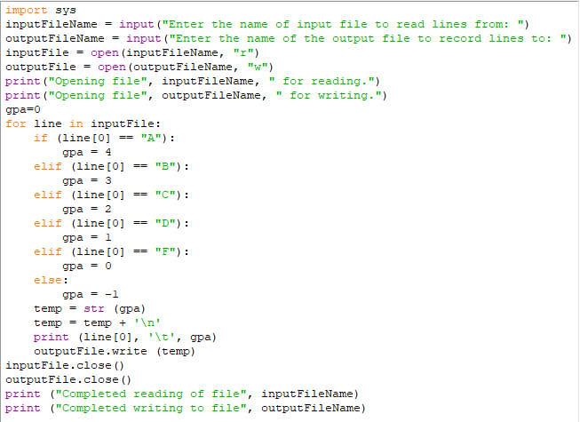
Writing To A File: Putting It All Together
Infile: “letters.txt” (se: newLetters.txt)
Notes:
Introduction to files in Pascal
27

Slide 28
Reading From Files: Commonly Used Algorithm
Pseudo-code:
Read a line from a file as a string
While (string is not empty)
process the line
Read another line from the file

Slide 29
File Input: Alternate Implementation
Name of the online example: grades3.py
inputFileName = input ("Enter name of input file: ")
inputFile = open(inputFileName, "r")
print("Opening file", inputFileName, " for reading.")
line = inputFile.readline()
while (line != ""):
sys.stdout.write(line)
line = inputFile.readline()
inputFile.close()
print("Completed reading of file", inputFileName)
Notes:
* Trace with a simple input file e.g., gpa.txt

Slide 30
Data Processing: Files
Files can be used to store complex data given that there exists a predefined format.
Format of the example input file: ‘employees.txt’
<Last name><SP><First Name>,<Occupation>,<Income>

Slide 31
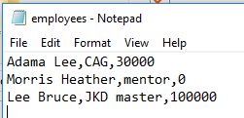
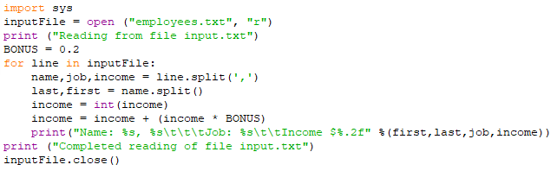
Example Program

Slide 32
Thank you!

